Slide 1
AI
INTERVIEW
MENTORS:
Mr. Venkata Krishna
Mr. Vasanth
Mrs. Divya
Mr. Aravind

Slide 2
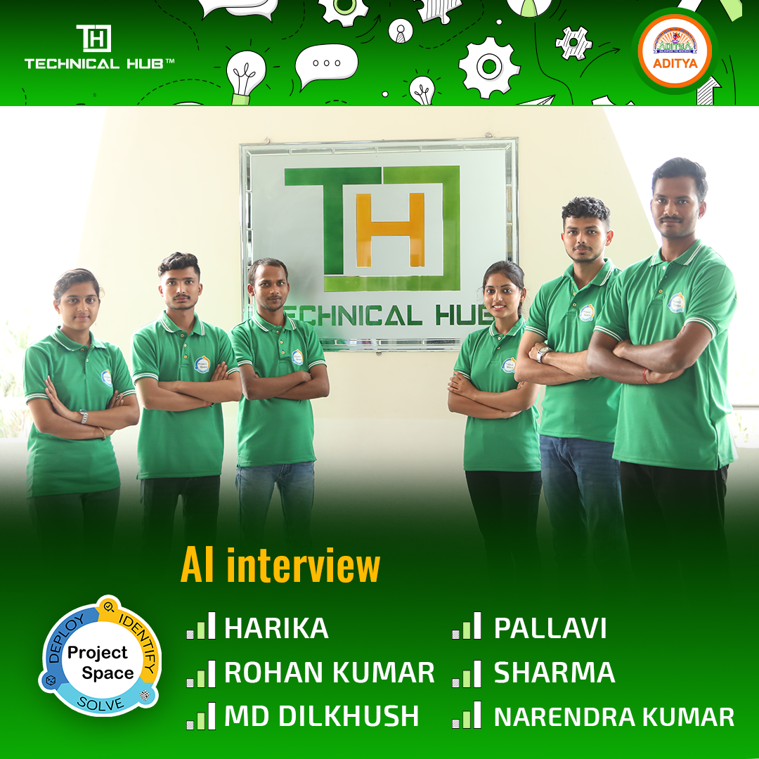
OUR TEAM

Slide 3
Problem Statement:
Many individuals face challenges in improving their English language skills, particularly in speaking, listening, and reading, which are crucial for success in various aspects of life, including job interviews. Additionally, preparing for interviews can be discouraging without proper guidance and practice. Therefore, there is a need for a mobile application that provision to these specific needs and assists users in enhancing their English proficiency and interview preparation.

Slide 4
An Overview Of The Problem:
Reading:
AI based paragraph generation.
User reading and speaking analysis.
Speaking:
AI based topic generation.
User speaking skill analysis.
Listening:
AI based audio generation.
User listening and understanding skills analysis

Slide 5
Our Expected Growth Path
User Assessment
comprehensive assessment on user's communication skills
Personalized learning path
user can practice according to their requirements and knowledge
Using various plugins, the app continuously adapts its content and exercises to match the user's progress and preferences
Adaptive Learning
Through consistent use and engagement, users achieve long-term mastery of their communication skills.
Long term Mastery

Slide 6
Project Work Flow
Project Planning and Research
Design Phase
Development Phase
Content Creation and Curation
Integration
Testing and Quality Assurance
Deployment and Launch

Slide 7





Technologies Used
Flutter
Dart
Firebase
Cloud Service
Figma

Slide 8
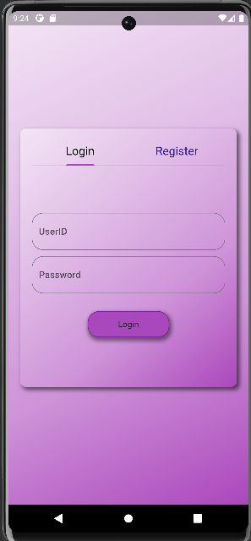
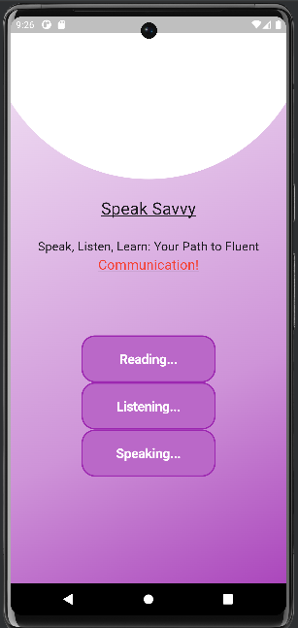
App Screens

Slide 9
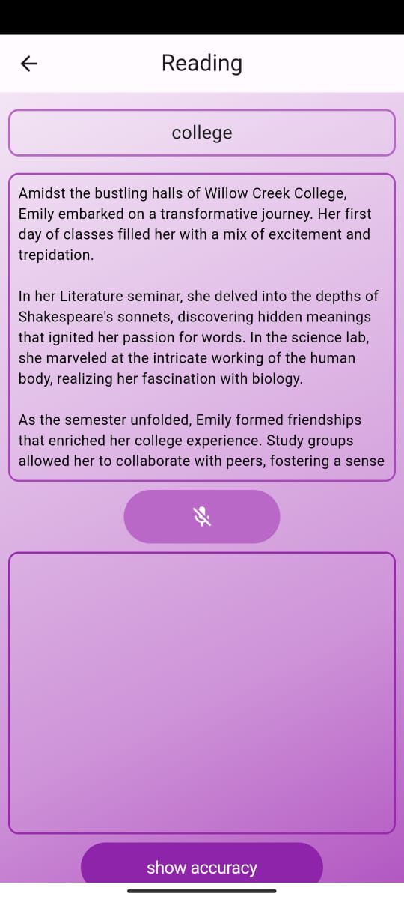
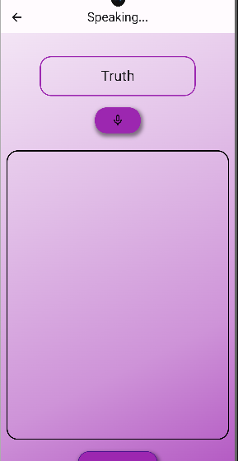
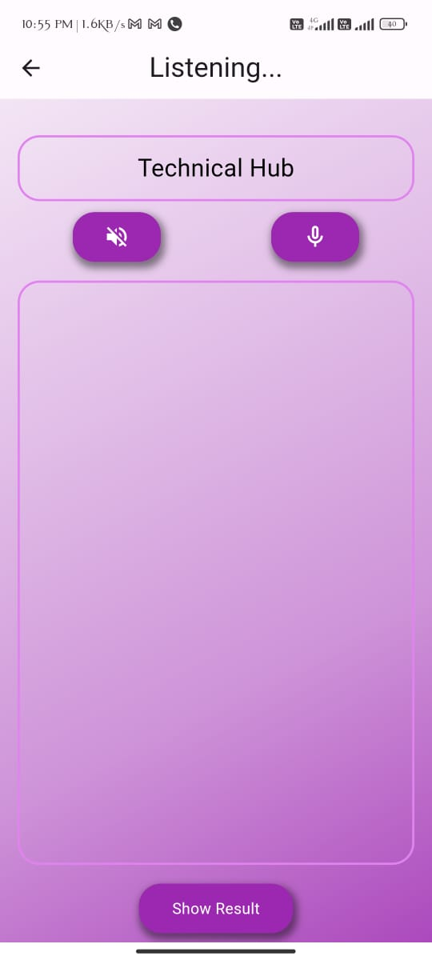

Slide 10
USE CASE:
Language Learning
English Language Exams Preparation
Job Seekers and Career Advancement
Self-Study and Distance Learning

Slide 11
Advantages:
Feedback and Improvement
Personalized Learning
Interactive Learning Experience
Comprehensive Skills Development
Progress Tracking and Motivation

Slide 12
Future Advancements:
Video Integration
Voice Analysis
Addition of Technology modules

Slide 13
THANK YOU

